Slide 1
Service Marketing and
Nonprofit Marketing

Slide 2
CONTENT:
The nature and main characteristics of services
Classification of services
Non-profit marketing (social marketing)
Questions for self-control
Tests for self-control
Questions of the seminar
Questions for discussion and assignment
Subjects of abstracts and reports
List of recommended literature

Slide 3

THE NATURE AND MAIN CHARECTERISTICS OF SERVICES
In recent years, the role of services in the economy has increased markedly. This is due to the complexity of production, saturation of the market with consumer goods, scientific and technical progress, leading to the emergence of new activities. Today, over 40% of global investment is in this area, mainly in trade, banking and insurance.
At the end of the 80s, the share of services in the GNP of developed countries approached 70%, while the share in the services sector increased. For comparison: in Germany, 41% of the workforce is involved in this area, in Italy - 35%, in the USA - 73%. As practice shows, our service sector is ahead of the manufacturing sector in terms of growth rates and the emergence of new types of services, its adaptation to the requirements of consumers and markets.

Slide 4

Service industries are extremely diverse, including the public sector with its infrastructure (hospitals, schools, police, post office, telegraph, etc.), and the private non-profit sector (museums, charitable organizations, etc.). The service sector also includes a significant share of the commercial sector: trade, transport, banks, insurance companies, advisory firms and other organizations.

Slide 5


In world statistics, another division of services has developed:
freight, including insurance, port charges and services;
other transport services;
tourism;
other services.
This is due to the fact that the share of tourism and transport services in the global trade in services accounts for 25% of their total volume.
It should be noted that in the marketing of services in the offer services prevail, and the goods complement it.
Services are any activities or benefits that one party can offer the other. Moreover, they are usually intangible and do not lead to ownership of anything. That is, having bought a product, we become its owner, which cannot be said about services. The production of services may be related to the production of goods in its material form (services provided during the sale of goods), or it may not be (consulting services).

Slide 6

New types of services are constantly appearing in society, such as:
new types of business services - real estate trade, information, marketing and advertising services, preparation of balance sheets;
services for the upbringing and education of children - governesses, private kindergartens and schools;
animal care services - their treatment, feeding and temporary maintenance;
other services in which there is a need for society.

Slide 7

Intangibility
Intangibility - the intangible nature is manifested in the fact that services cannot be demonstrated, tried, seen, transported, stored, packaged or studied until they are received.
But here there are many problems, both for the buyer and the seller of the service. The first should believe in the words of the second, since it is difficult to show the goods, and it is even more difficult to explain to customers what they are paying for. The second can only describe the benefits of services, focusing on marketing keywords, such as - benefits, benefits. The client can evaluate the services themselves only after their implementation, and even then not always, for example, medical services.

Slide 8
To build trust between counterparties, a service provider organization can take a number of measures:
increase, as far as possible, the tangibility of their services;
emphasize their importance;
focus on the benefits of services;
attract some celebrity to their propaganda.
To increase the materiality of services, to make it more tangible can the presence of an element of a product in a service in a wide variety of forms. This may be a simulation of future appearance in a beauty salon on a computer; providing customers with information about employees, their experience and qualifications; brochures, booklets and other tangible symbols that help to understand and appreciate the organization’s services. For example, a report containing data analysis and recommendations is the material carrier of a service such as market research.

Slide 9
To measure relative tangibility, you can offer a scale of tangibility:
1. I have a very clear idea of ​​this service (stuff).
2. Representation (image) arises immediately.
3. The presentation is very tangible.
4. This is a very abstract thing for the image.
5. This is a very difficult thing to imagine.
6. This thing is easy to describe to another person.
7. This thing evokes various images.
8. This thing is hard to portray.
9. I feel that I have a clear idea of ​​this thing.
Studies of the perception of goods and services conducted on this scale showed that some services (cinema, dry cleaning, cleaning) are perceived by consumers more tangibly than goods, and, conversely, some goods (used cars) are more intangible than services.

Slide 10

The continuity of production
and
consumption of services
Services are inseparable from their provision. Experts believe that this is the most important factor that makes the service distinctive from the product.
With the inextricable relationship of production and consumption of services, the degree of contact between the seller and the client can be different.
An important competitive advantage of enterprises in the service sector is the high professional level of knowledge and skills of service sellers, which the buyer often considers as a kind of expert.
In those areas where contacts with consumers are insignificant, the technical qualifications of personnel play the largest role. For services that do not require highly qualified personnel, the choice of clients is much wider and the choice itself is often carried out spontaneously.

Slide 11
Variability of quality - variability of services
The quality of the service pretty much depends on who provides them, as well as where and when they are provided. In one hotel the service is high quality, in another it is not. At the hotel itself, one administrator is polite and executive, while the other is arrogant. Even the same employee during the day provides services differently depending on physical condition and mood. Expressions like “My life is in your hands” describe the situation well.
Most often, inconsistency in the quality of services is associated with factors such as:
qualifications of employees;
lack of competition;
poor training and staff training;
lack of communication and information;
lack of regular support from managers;
personal traits of the character of employees;
a high degree of individuality of services and the need to consider the behavioral factors of each client.

Slide 12
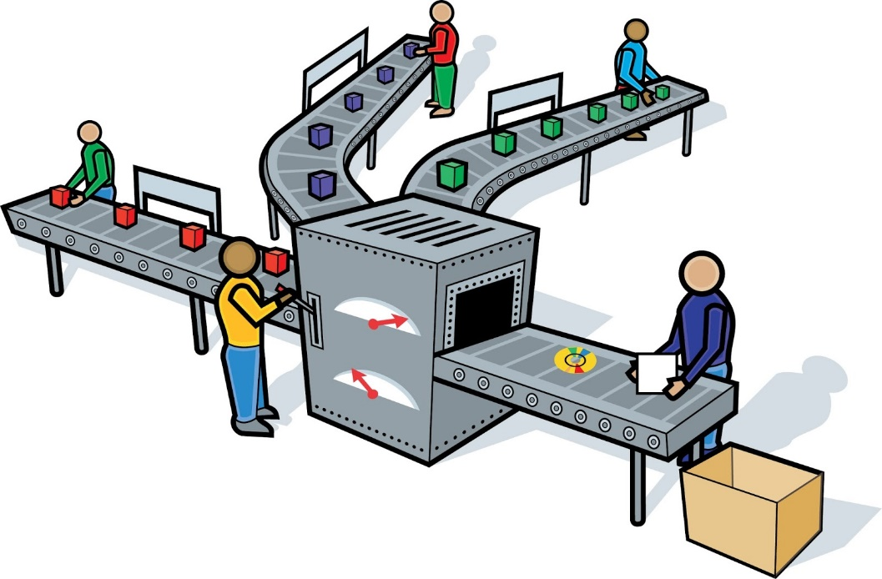

Today, the trend in the service sector is aimed at increasing standardized procedures and reducing the complexity of work through the use of production lines and automation of labor. Examples of such a situation are automatic car wash stations, McDonald's restaurant services, direct dialing of numbers on the international telephone network, etc.
To reduce the variability of services, firms are developing service standards. This is a set of binding customer service rules that are designed to guarantee the established level of quality for all production operations.

Slide 13


This is a kind of criteria by which the level of customer service and the activities of any employee of the company are evaluated. These include:
service time;
work with complaints and claims and answers to them;
the presence in the office of information and advertising materials;
maximum waiting time for a response by phone;
requirements for the execution of documents, letters, business papers and other formal criteria up to the requirements for clothing and the appearance of employees.
The initial stage in the formation of a service standard can be considered the development of a corporate identity. This includes the name of the organization, its trademark, corporate color, logo (rules for spelling the name).
All attributes of the organization, including signs, business cards, letterheads, as well as promotional and souvenir products of the company (calendars, pens, folders, etc.) must be decorated in this style. In addition, it is necessary to systematically conduct training and staff training so that all employees have mastered service standards.

Slide 14
Inability of the service to storage
An important distinguishing feature of the service is its “momentary nature”. Services cannot be saved for further sale and presentation. Unoccupied hotel rooms, unsold airline tickets cannot be restored.
The reason why many doctors charge a fee for a patient who did not show up because the cost of the service existed right at the time the patient did not appear. In the face of volatile demand, it may be necessary to regulate consumption in order to ensure constant demand over different periods of time. For example, in the summer, the number of passengers increases. Therefore, to meet demand, it is necessary to have more vehicles in summer than in winter. If the cinema has 500 seats, then it cannot accept more than 500 spectators on Saturday evening, even if there were 400 empty seats in the morning session.

Slide 15
Service Classification
Traditionally, in world practice, the most complete list of services includes: transport, tourism, insurance, banking and other financial operations, construction and engineering, communications, information and computing services, real estate and equipment rental, labor hire services, film rental and television programs, management consulting, legal, technical and other professional services.
In Kazakhstan, a different definition of service industries has developed. Some of the services listed were included in material production — for example, transport, communications, construction, and most were related to intangible production: housing and communal services; consumer services; education, culture and art; healthcare and social security.
Moreover, until recently, certain types of services were almost completely absent or not officially recognized (real estate and currency transactions, tutoring, and others).

Slide 16
The main objectives of the classification:
Determine the most important characteristics of this phenomenon, which distinguish it from others and therefore deserve special consideration.
Consider the extent to which these distinguished characteristics may be inherent in other classes.
Improve understanding of the phenomenon under study.

Slide 17
Classification is the process of separating a phenomenon and spreading its parts into specific classes and categories.
In marketing, there are many principles of classification or segmentation; show some of them:
market classification (international, domestic, industrial, consumer, services market);
consumer segmentation according to some criteria: social groups, income level, reaction to new goods and services, etc .; end consumers and consumer organizations; customer presence required, optional, etc.
classification of goods and services according to any criteria: consumer goods, durable goods, elite goods, etc .; commercial, non-commercial; individual, general; tangible, intangible, etc.
classification by source of services, that is, qualifications of service sellers and the degree of their contact with consumers: people (professionals, skilled or unskilled workers); machines (automatic machines; devices controlled by highly or unskilled operators).
Classification of services and improving their accounting is an important global problem. There are different approaches and the most common one is Lovelock. The main thing in this classification is who (what) the services are aimed at and whether they are tangible or not.

Slide 18

Non-profit marketing
Non-profit marketing is carried out by organizations and individuals who act in the public interest or advocate for an idea and do not seek to make a profit. Both in non-commercial marketing and commercial, consumers can choose between the offer of various organizations, while they can be both satisfied and dissatisfied with their activities.

Slide 19
Marketing organizations requires evaluating its existing image and developing a marketing plan to improve it. An image (image) is a representation of an object that a group of individuals or an individual has.
The marketing of individuals is associated with the formation of an image in relation to political candidates or celebrities (actors, singers, businessmen, etc.). This can be done by celebrities themselves (self-marketing), or by inviting specialists in this field: impressionario, press secretaries, image makers, etc. So, for example, in the newspaper Izvestia there was a message: “During a trip to Energomash, Boris Yeltsin appeared accompanied by his image maker A. Mintusov. For the first time with a group of his colleagues - psychologists, political scientists, analysts working in a private firm Public Relations - A. Mintusov ensures the creation of the required image of a presidential candidate ... "

Slide 20
There are four types of place marketing:
housing marketing, which includes the development or offer for sale or rental of housing;
marketing of economic development zones - development, sale or leasing of land or property such as factories, shops, offices, warehouses, etc.
marketing of investments in land ownership - this is actually an addition to the previous paragraph (b), however, the aim here is to invest in real estate, with the intention of reselling it at a higher price in the future and thereby receive income.
marketing of vacation spots aims to attract vacationers and tourists to specific cities, regions and countries. Travel agencies, trade unions, government agencies, etc. do this.

Slide 21

Idea marketing in a sense is any kind of marketing. More specifically, here one can single out special ideas (environmental protection, consumer protection, anti-smoking, etc.) and scientific and technical ideas (the use of new technologies or the use of new methods of agronomy, etc.).

Slide 22

QUESTIONS FOR SELF-CONTROL
Define the concept of “service” and talk about its four features.
Correlate the four main characteristics inherent in services with the purchase of a movie ticket, a vacation trip, and car repair. Which of them are closer to the goods, and which to the services?
In what areas in society is the emergence of new types of services? Explain this with service diversification and service standardization. What service criteria do you know?
What are the ways to regulate supply and demand in the service sector? Give examples.
What are the goals of the classification of services and their specifics for Kazakhstan?
What types of service classification do you know? Give examples.
Explain why and how organizations are engaged in self-marketing?
Why do we need marketing of territories, organizations, people and ideas? What is he like?
Correlate the five components of the marketing mix with a social and public marketing company.

Slide 23

QUESTIONS OF THE SEMINAR LESSON
"MORAL, SOCIAL PROBLEMS OF MARKETING"
The main characteristics of the service. Content: Classification of services, specifics of developing a complex of marketing services.
Segmentation of the market for services. Content: competitive advantages in the service sector, especially production, promotion, distribution and pricing.
Marketing in the field of non-profit activities. Content: characteristics and characteristics of non-profit organizations, the exchange process in non-profit marketing.
Marketing organizations, its elements. Content: organization of public opinion, political marketing, ego-marketing, self-marketing: concept, features; marketing of places, the main types of marketing of places, marketing of ideas, its essence, public marketing, the process of planning public marketing.

Slide 24

SUBJECTS AND REPORTS
Features of marketing services.
Marketing celebrities.
Political marketing.
Career in marketing.
Marketing of vacation spots.

Slide 25
LIST OF RECOMMENDED LITERATURE:
Алешина, И. В. Паблик рилейшнз для менеджеров : учеб. пособие / И. В. Алешина. – М. : ГНОМ-ПРЕСС, 2003.
Анурин, В. Маркетинговые исследования потребительского рынка / В. Анурин, И. Муромкина, Е. Евтушенко. – СПб. : Питер, 2004. – 270 с.
Беляевский, И. К. Маркетинговое исследование: информация, анализ, прогноз : учеб. пособие / И. К. Беляевский. – М. : Финансы и статистика, 2001.
Блэкуэлл, Д. Поведение потребителей / Д. Блэкуэлл, П. Миниард, Дж. Энджел. – СПб. : Питер, 2002.
Бронникова, Т. С. Маркетинг, теория, методика, практика : учеб. пособие для вузов / Т. С. Бронникова, А. Б. Косолапов. – М. : КноРус, 2007.
Гордон, Я. Х. Маркетинг партнерских отношений / Я. Х. Гордон. – СПб. : Питер, 2001.
Моисеева, Н. К. Управление маркетингом: теория, практика, информационные технологии : учеб. пособие / Н. К. Моисеева, М. В. Конышева. – М. : Финансы и статистика, 2002.
Есимжанова С.Р. Маркетинг в Казахстане: теория, методология, практика. – Алматы: Аян Эдет, 2004.
Шеденов У.К., Ильясов Д.К. Теория маркетинга и менеджмента в сфере услуг. – Алматы, Қазақ университеті, 2002.

